Slide 1
Software Dependability
AUTOMATIC SOFTWARE VULNERABILITY TESTING
(SQL INJECTION)
Group Members Professor CoordinatorS
SYED HUSSNAIN RAZA RIZVI FABIO PALOMBA
ELSAYED ELSAYAD
MUHAMMAD WASSEM
EMANUELE IANNUONE
GIAMMARIA GIOARDANO

Slide 2
CONTENTS
Introduction
Context of Project
Goals of Project
Methodological steps of testing
Testing and Findings
Conclusion

Slide 3
Introduction
Today there are large number of web applications that are widely available, and millions of users have access to those web applications worldwide.
that often suffer from inherent vulnerabilities such as buffer overflow, SQL Injection, format string bug, and cross site scripting (XSS). Moreover, these applications are not always used by legitimate users in a legitimate manner. As a result, exploitations of these known vulnerabilities through successful attacks are very common.
According to the OWASP (Open Web Application Security Project), among several vulnerabilities the SQL injection is one of the most common and threatening in the web applications.

Slide 4
Introduction
Normally, by utilizing the SQL injection, the databases and the web servers are attacked by the attackers and with the help of this technique the content of webpage can be manipulated and the possibility to getting stollen an important information of a person or any organization.
Therefore, it’s significantly important to test the web applications against the vulnerability of SQL injection and make them more dependable and reliable for the users or the organizations.

Slide 5
Context of Project
The Project is based on reviewing and testing web applications to analyze the vulnerabilities of SQL injection in each of those web applications.
A successful SQL injection attack can result in unauthorized access to sensitive data, such as passwords, credit card details, or personal user information.
SQL injection vulnerabilities can be found quickly and reliably using some plugins within the IDE.
SQL injection can also be detected manually by using a systematic set of tests against every entry point in the application.

Slide 6
Goals of Project
Review open-source web applications to find any SQL injection vulnerability.
Try to analyze the SQL injection vulnerabilities reasons, impacts, finding, and how to secure the web application against.
Report on any vulnerability found, and contribute in securing those web application against vulnerabilities if possible.

Slide 7
Methodological Steps of Testing
For testing the open-source java-based web applications we used IntelliJ and NetBeans IDEs.
• SpotBugs: IntelliJ SpotBugs plugin provides static byte code analysis to look for bugs in Java code
from within IntelliJ IDEA.
• FindBugs: FindBugs is an open source defect detection tool designed to find bugs in Java programs.

Slide 8
Testing and Findings
In testing phase, we worked on over 15 open-source java-based web applications and analyzed the vulnerabilities in them.
Some examples of projects we have worked on:
1- School Admin System 2- Flight Booking
3- Hospital Management System 4- Transport Automations System
5- ATM Machine 6- Exam Counter
7- Hotel Management Project 8- Smart Bus Ticket Management System

Slide 9
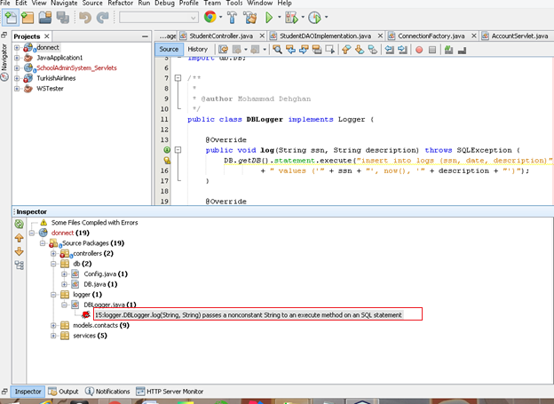
Testing and Findings
After testing several projects, we found some
SQL injection vulnerabilities, as shown:

Slide 10
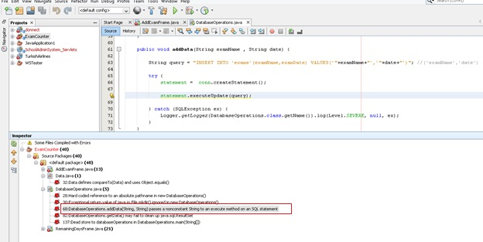
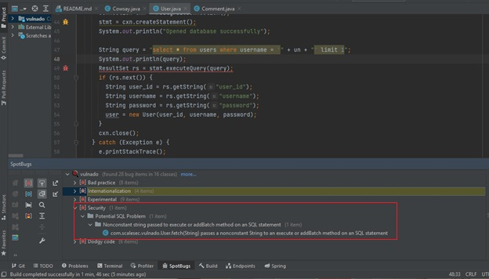
Testing and Findings

Slide 11
Conclusion
Testing plays an important role to analyze and secure the web applications against the possible vulnerabilities, and it is very important to prevent the damages and exploitations after the development of the application. There are number of techniques for the testing of web applications have been proposed against the major vulnerabilities like SQL injection. In this work, we have tested over 15 open-source java-based projects with the help of several frameworks, tools, and plugins. In the results, we have found several vulnerabilities related to SQL injection in some of the projects and by analyzing the vulnerabilities we have proposed the solutions in order to fix the issues which can cause bad impact to the users of the web applications.

Slide 12
thank YOU

